Slide 1
Object Oriented
Programming
(Class & Objects)

Slide 2
Class
Class is a software structure that is important in Object Oriented Programming, it is called as a template of an object.
Class has data members: Variables & Functions.
A class is a collection of objects of similar type.
Once a class is defined, any number of objects can be created which belong to that class.
Blue print or prototype for an object
Contains the common properties and methods of an object
Few examples are : Car, Person, Animal
Notes:
Class Person
Properties: Name, Height, Weight etc
Methods: Run, Walk, Speak

Slide 3


Slide 4
Object
Object is an instance of a class.
Object gives life to a class.
Objects are the basic run-time entities in an object-oriented system.
When a program is executed, objects interact with each other by sending messages.
For eg. : Ajay, Swift and Jimmy are objects belonging to Person, Car and Animal class.
Notes:
Public Class Test
Dim a As Integer
Sub Print()
Console.WriteLine(“Hello”)
End Sub
Public Function add(ByVal a as Integer, ByVal b as Integer) as Integer
Return (a+b)
End Function
End Class
Module M1
Sub Main()
Dim t as New Test() ‘ Creating Object for the class Test
t.print() ‘ Calling sub routine print
End Sub
End Module

Slide 5





Slide 6
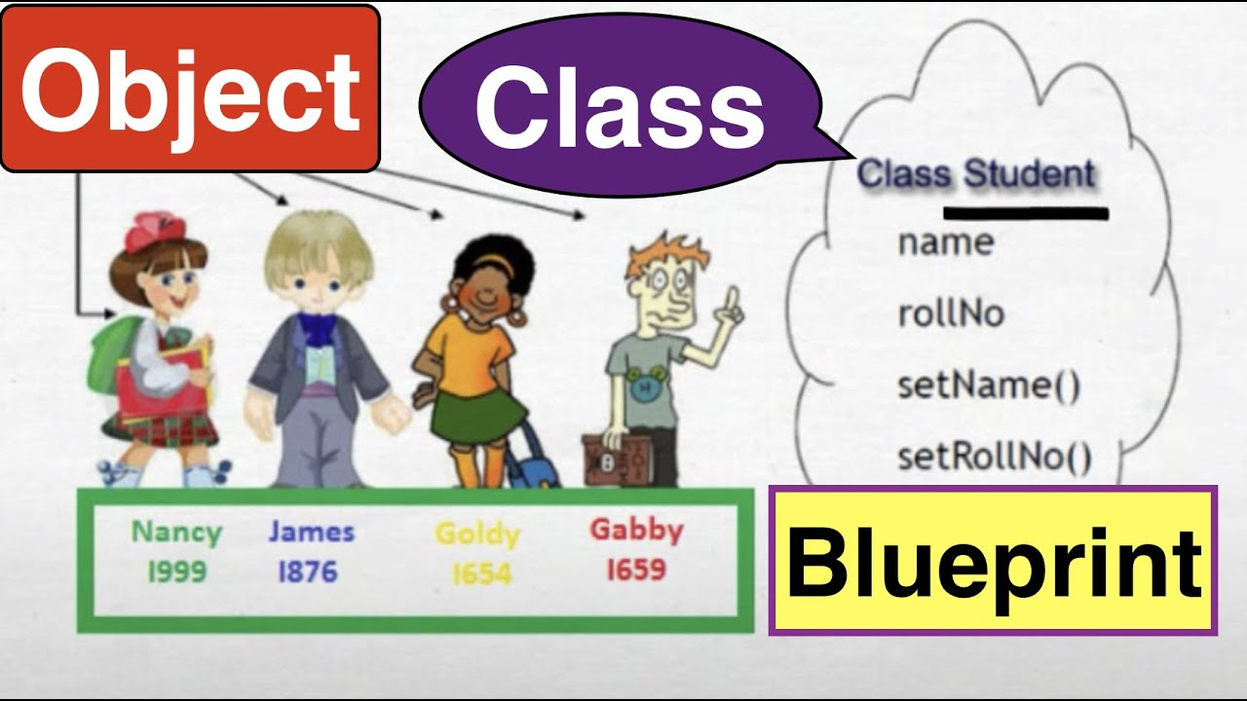

Slide 7
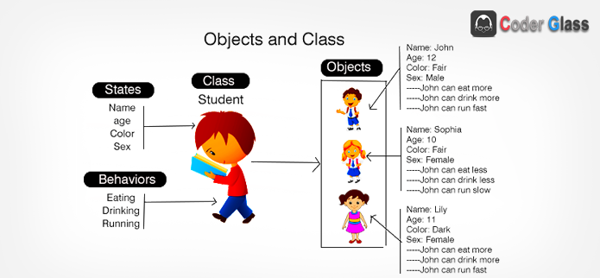

Slide 8
Creating
Classes

Slide 9
class ClassName
{
variable list;
methods()
{
}
}

Slide 10
class Car
{
int no_of_gears, speed;
public void changeGear()
{
}
}

Slide 11
Creating
Objects

Slide 12
You can create an object of class with the following syntax: -
ClassName obj = new ClassName( );
So the car class object can be created as:
Car c = new Car( );

Slide 13
The object creation statement has three parts.
Car c = new Car( );
Declaration
Instantiation
Initialization
1. Declaration
2. Instantiation
3. Initialization

Slide 14
Declaration
You declare variables of int type as: -
int a;
You can say that a is a variable who can refer to any type of int data.
Classes in java are also types so you can declare class type variable as: -
Car c;
You can say that c is a variable who can refer to any type of Car.

Slide 15

Declaring a variable do not create any object.
The code Car c; does not create a new car object, it just declare a variable named c that will be used to refer to a Car object.
The reference is still empty until assigned with a new keyword.
The empty reference is called null reference in java.
c

Slide 16
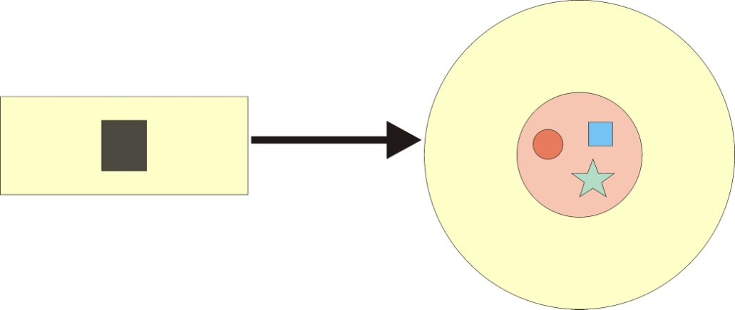
Instantiation
The new operator instantiates a class by allocating a memory for a new object. The new operator returns a reference to the object it created and this reference is assigned to the appropriate variable.
c
Car object

Slide 17
Initialization
The object is always initialize by calling a constructor.
A constructor is a special method which has a same name as class and used to initialize the variables of that object.
In this case the Car class object is initialized by calling the constructor of Car class Car( );

Slide 18
this
Java this keyword is used to invoke any method or variable of current class.
The syntax of method is: -
this.methodname( );
The syntax of variable is: -
this.variablename = 7;

Slide 19
Methods

Slide 20
Method
A method is a group of programming language statements with a given name.
Method syntax
Returntype methodname(parameters)
{
statement 1;
statement 2; …..
}

Slide 21
Method has two major parts:
Method Declaration
Method Body
Declaration
void sum ( int a, int b )
{
statement 1
statement 2
……..
}
Body

Slide 22
Method that does not
return a value
If a method does not return a value, its return type must be declared void.
For example:
void display( )
{
System.out.println(“Welcome to K2”);
}

Slide 23
Method that returns a value
Methods that have a return type other than void return a value to the calling routine using the following form of the return statement.
return value;
int add( )
{
return 5+5;
}

Slide 24
Polymorphism
The word polymorphism means having many forms.
In simple words, we can define polymorphism as the ability to take more than one form.
It is mainly divided into two types:
Compile time Polymorphism
Runtime Polymorphism

Slide 25


Slide 26
Polymorphism
Compile Time
(Static or Early Binding)
Overloading
Method
Runtime
(Dynamic or Late Binding)
Overriding
Operator
Unary
Binary
X

Slide 27
Method
Overloading

Slide 28
Method Overloading
In java, it is possible to define two or more methods with the same name, within the same class.
They share the same name as long as their parameters are different.
This process is known as “method overloading”.

Slide 29
When java call an overloaded method, it simply executes the version of the method whose parameters match the arguments.
Two methods are overloaded if there:
No. of parameters are different
Type of parameters is different
Order of parameters is different

Slide 30
1. No of parameters are different
void add(int i, int j)
{
System.out.println(i+j);
}
void add(int i, int j, int k)
{
System.out.println(i+j+k);
}
void add(int i, int j, int k , int m)
{
System.out.println(i+j+k+m);
}

Slide 31
2. Type of parameters is different
public void add(int i, int j)
{
System.out.println(i+j);
}
public void add(double i, double j)
{
System.out.println(i+j);
}
public void add(float i, float j)
{
System.out.println(i+j);
}

Slide 32
3. Order of parameters is different
public void add(double i, int j)
{
System.out.println(i+j);
}
public void add(int i, double j)
{
System.out.println(i+j);
}

Slide 33
Constructor

Slide 34
Constructor
Constructor is a special method in java class.
It is used to initialize a new object variables.
If we are not providing any constructor for a class then default (no parameter) constructor is automatically provided by the runtime system.

Slide 35
Rules for Defining Constructor:
A constructor & class name must be same.
Constructors do not return any values not even void.
Constructor can be private, protected or public.
Constructors are called automatically when an object is created.
Overloading of constructors is possible.
Java supports only default & parameterized Constructor

Slide 36
If you want to invoke another constructor of current class inside constructor you can use this statement as follows:
this(4, 5);
The above statement will invoke the current class constructor that takes two int arguments.
Call to current class constructor with this would be the first statement in the constructor.

Slide 37
Destroying
Objects
(Garbage Collection)

Slide 38
Object Destruction & Garbage Collection
Some programming languages required that you keep track of all the objects you create and then you explicitly destroy them when they are no longer needed.
The Java platform allows you to create as many objects as you want and you don't have to worry about destroying them.

Slide 39
The Java runtime environment deletes objects when it determines that they are no longer being used. This process is called garbage collection.
An object is eligible for garbage collection when there are no more references to that object for example if object goes out of scope.
You can explicitly drop an object reference by setting the variable to the special value null.

Slide 40
If you want to invoke garbage collector in the program you can do this by issuing following commands.
System.gc();
Runtime.getRuntime().gc();

Slide 41
finalize() method
If you want an object to clean up its state before it is deleted from the memory, you can declare finalize() method in the class.
This method will be called by the garbage collector before deleting any object of this class.

Slide 42
This method is inherited from the parent Object class in all java classes and can be overridden like the following code:
protected void finalize()
{
super.finalize();
//clean up code here.
}

Slide 43
Class Variable
vs.
Instance Variable

Slide 44
Class vs. Instance Variables
Class variable
Instance variable
Class variable is declared by using static keyword.
static int a=4;
Instance variable is declared without static keyword.
int a = 4;
All objects share the single copy of static variable.
All objects have their own copy of instance variable.

Slide 45
Static variable does not depend on the single object because it belongs to a class.
Instance variable depends on the object for which it is available.
Static variable can be accessed without creating an object, by using class name.
ClassName.variable
Instance variable cannot be accessed without creating an object.
ObjectName.variable

Slide 46
Class Methods
vs.
Instance Methods

Slide 47
Static vs. Instance Methods
Static Method
Instance Method
Static methods are declared by using static keyword.
instance methods are declared without static keyword.
All objects share the single copy of static method.
All objects have their own copy of instance method.

Slide 48
Static method does not depend on the single object because it belongs to a class.
Instance method depends on the object for which it is available.
Static method can be invoked without creating an object, by using class name.
ClassName.method();
Instance method cannot be invoked without creating an object.
ObjectName.method( );

Slide 49
Static methods cannot call non-static methods.
Non-static methods can call static methods.
Static methods cannot access not-static variables.
Non-static methods can access static variables.
Static methods cannot refer to this or super.
Instance methods can refer to this and super.

Slide 50
Static Blocks
There are also static blocks of code in java, which have the following syntax:
static
{
statements;
}
These blocks are used to initialize the variables and execute at class load time.

Slide 51
Encapsulation
(Data Hiding)

Slide 52
Encapsulation
Packaging an object's variables within the protective custody of its methods is called Encapsulation.
Calling Object
age
get…
set…

Slide 53
A powerful benefit of encapsulation is the hiding of implementation details from other objects.
The internal portion (variables) of an object has more limited visibility than the external portion (methods).
This will protect the internal portion against unwanted external access.

Slide 54
Implementing Encapsulation
First step is to create the variables of the object private so that nobody can access them from outside.
private int age;
Second step is to provide public setters and getters methods for accessing the private variables.
public void setAge(int age)
{
this.age = age;
}
public int getAge()
{
return this.age;
}

Slide 55
public class Demo
{
private int age;
public void setAge(int age)
  {
  if(age<=0)
  {
  System.out.print(“Invalid Age”);
  }
  else
  {
  this.age = age;
  }
  }
public int getAge()
  {
  return this.age;
  }
}

Slide 56
Access
Modifiers

Slide 57
Access Modifiers
Access modifiers define various levels of access between class members and the outside world (other objects).
They allow us to define the encapsulation characteristics of an object.
There are four access modifiers in java:
1. private
2. protected
3. public
4. default.

Slide 58
private
The private access modifier is the most restrictive; it specifies that class members are accessible only by the class in which they are defined. This means that no other class has access to private class members, even subclasses.
private int a = 4;
private void show( )
{
}

Slide 59
A
B
C
D
private int a;
Package 1
Package 2
private variable a is only accessible in A class.

Slide 60
protected
This modifier specifies that class members are accessible only to methods in that class, the classes inside the package and subclasses of that class outside the package.
protected int a = 4;
protected void show ( )
{
}

Slide 61
A
B
C
D
protected int a;
Package 1
Package 2
protected variable a is accessible inside A class and inside child class which can be in same package or different package.

Slide 62
public
The public access modifier specifies that class variables and methods are accessible to anyone, both inside and outside the class. This means that public class members have global visibility and can be accessed by any other object.
public int a = 4;
public void show ( )
{
}

Slide 63
A
B
C
D
public int a;
Package 1
Package 2
public variable a is accessible from all 4 classes in any package.

Slide 64
Default Access Modifier
The default (package) access modifier specifies that only classes in the same package can have access to a class's variables and methods.
There is no actual keyword for declaring the default access modifier.
it is applied by default in the absence of any access modifier.

Slide 65
A
B
C
D
int a;
Package 1
Package 2
Variable a is accessible only inside Package 1.

Slide 66
Wrapper class
Wrapper class in java provides the mechanism to convert primitive into object and object into primitive.
Since J2SE 5.0, autoboxing and unboxing feature converts primitive into object and object into primitive automatically.
The automatic conversion of primitive into object is known and autoboxing and vice-versa unboxing.

Slide 67
Primitive Type | Wrapper class
boolean | Boolean
char | Character
byte | Byte
short | Short
int | Integer
long | Long
float | Float
double | Double
Autoboxing
Unboxing

Slide 68
Wrapper class
All of the primitive wrapper classes in Java are immutable i.e. once assigned a value to a wrapper class instance cannot be changed further.
Features Of the Wrapper Classes
All the methods of the wrapper classes are static.
The Wrapper class does not contain constructors.
Once a value is assigned to a wrapper class instance it can not be changed, anymore.

Slide 69
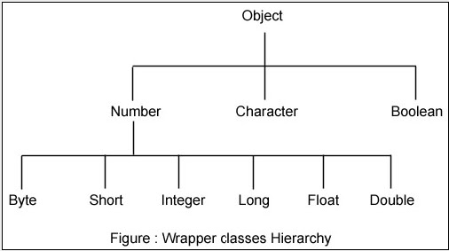

Slide 70
Package
A java package is a group of similar types of classes, interfaces and sub-packages.
Package in java can be categorized in two form, built-in package and user-defined package.
There are many built-in packages such as java, lang, awt, javax, swing, net, io, util, sql etc.
The package keyword is used to create a package in java.
Package inside the package is called the subpackage.

Slide 71
Advantage of Java Package
Java package is used to categorize the classes and interfaces so that they can be easily maintained.
Java package provides access protection.
Java package removes naming collision.

Slide 72
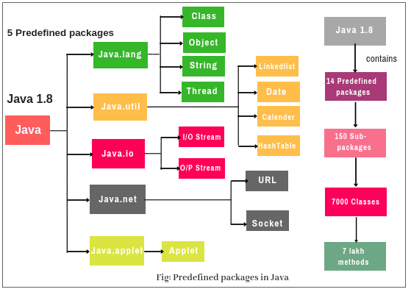

Slide 73
import statement
Java provide a solution to limit the use of fully qualified name each time you create an object.
You can just import the class you need with import statement.
To import a specific member into the current file, put an import statement at the beginning of your file before any class or interface definitions but after the package statement, if there is one.

Slide 74
9130013411
Thank You

